Slide 1
Predicting NBA Point Spreads
Andrew Adelson

Slide 2
What is a point spread?
A point spread is a sports betting term
Casinos in Vegas hire odds makers to create models to predict an outcome for the score differential between two teams in a game.
For example, the point spread for the NBA Finals Game 4 is -6 for Golden State. This means that Golden State should when by approximately 6 points on average.
If we bet on Cleveland’s side, it would be +6.

Slide 3
Why should we care?
As data scientists, we can build models. What if our models result in a difference of opinion from the Vegas models?
If we trust our models [and are gamblers], we should put our money where our math is.
The reason anyone [should] gamble is because they feel strongly that their opinion is more correct than someone else’s opinion.
It’s much easier when you are betting a friend. In this case, I seek to bet against Vegas. Good luck me.

Slide 4
The Vegas Cut
Okay, so let’s say I build a model that predicts with 52% accuracy the correct side.
Well I am still losing.
Vegas makes its vig so a return on a point spread bet is roughly 90%.
What is my expected result if I bet a dollar?
52% I win 90 cents
48% I lose $1
Expected Value = .52*(.9)+.48*(-1) = -.012
ROI = -1.2%
That’s not good

Slide 5
What’s my break even point?
Let’s do some algebra:
X*(.9) + (1-X)*(-1) = 0
X = 10/19 = 52.6315%
So, I need to win 52.63% of the time to break even assuming they take a 10% rake.

Slide 6
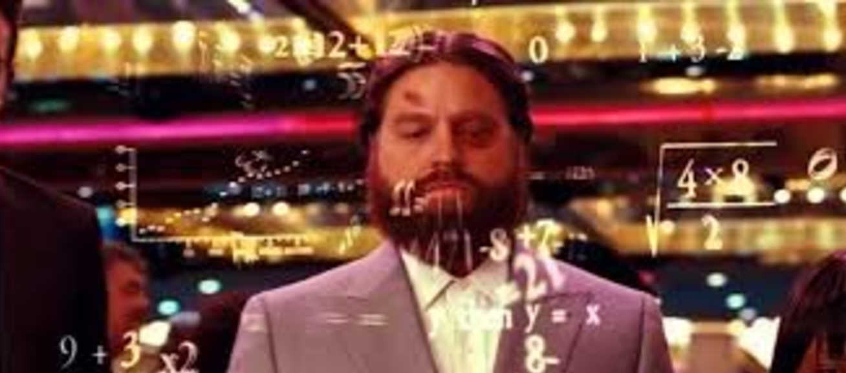
Goal:
Build a model that correctly predicts the right side of the point spread at least 52.6315% of the time.

Slide 7
Methodology
I used box score data from ONLY the 2016-2017 season.
A box score is all the player statistics for a particular game, ranging from three pointers attempted to turnovers.
I used these stats to create features in my model.
I can only use the data up to a particular game. So, if the Thunder play on December 15, 2016, then I can only use the Thunder’s statistics up to that date.

Slide 8
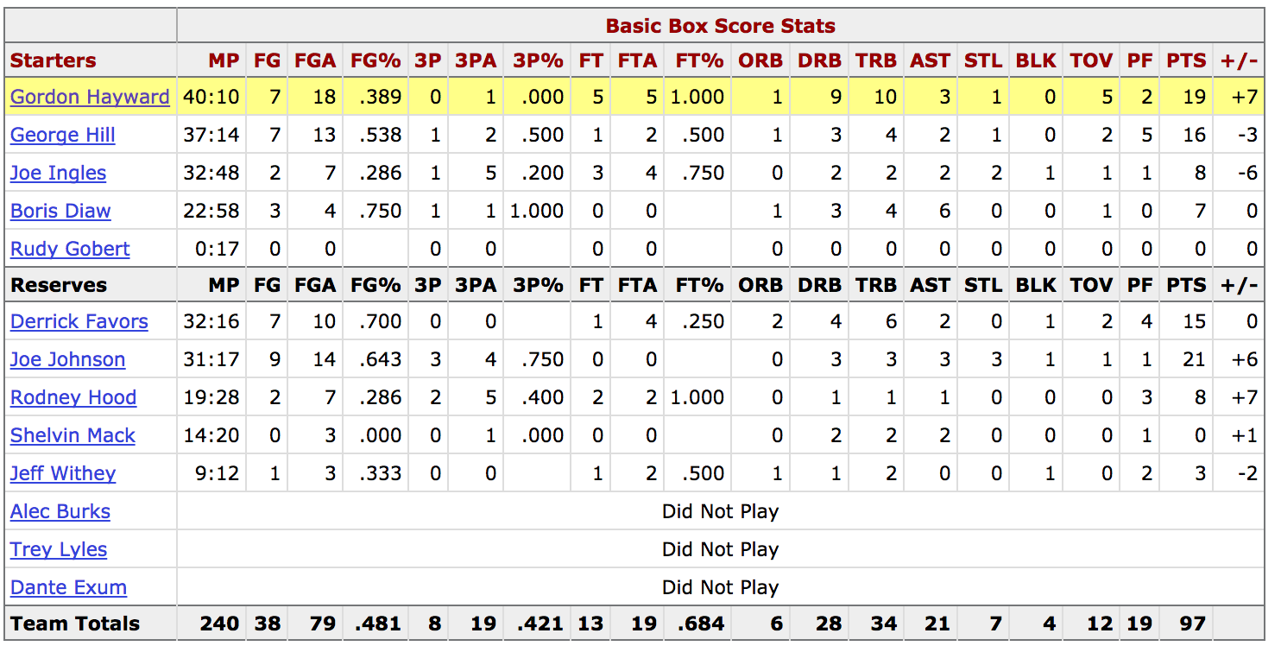
Box Score Example

Slide 9
Important Decision
I only use ¾ of the regular season games in my model
I consider the first ¼ of the season to have inconclusive statistics
For example, if the 76ers score 140 points in their first game, then the model make an incorrect prediction for the next game using this statistic.
Everyone knows the 76ers suck.

Slide 10
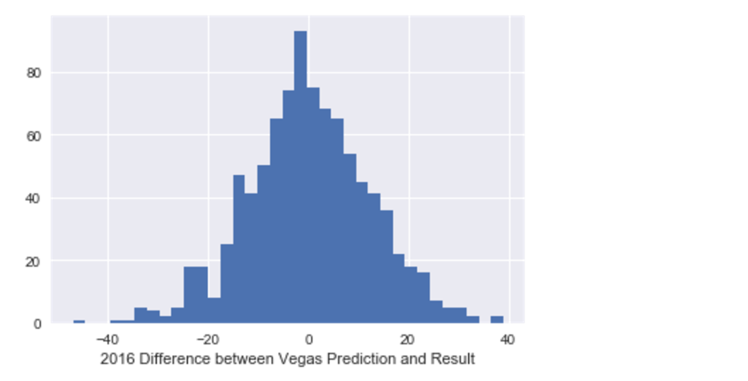
How were the Vegas lines in 2016?

Slide 11
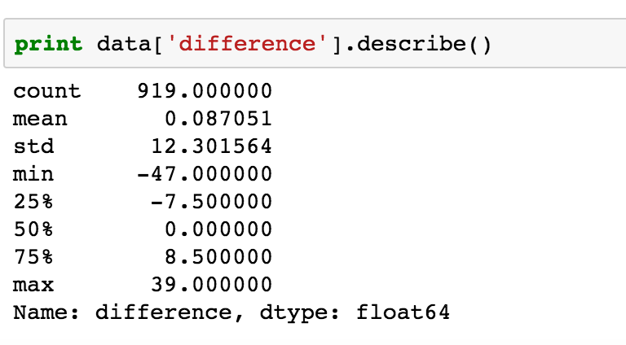
Summary Statistics for 2016

Slide 12
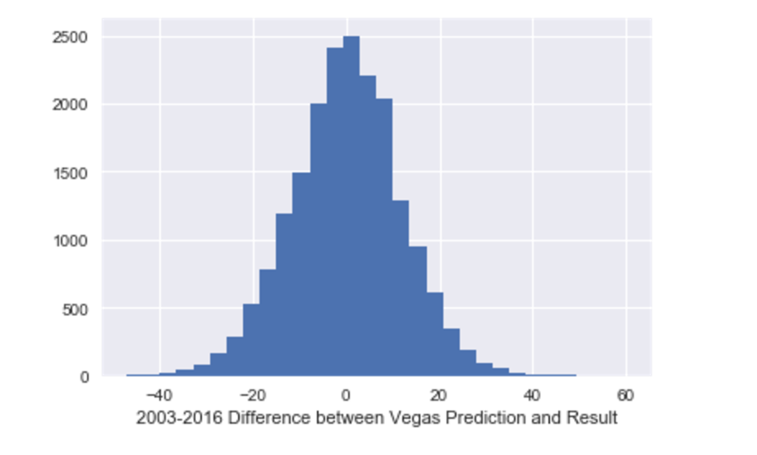
What about Vegas since 2003?

Slide 13
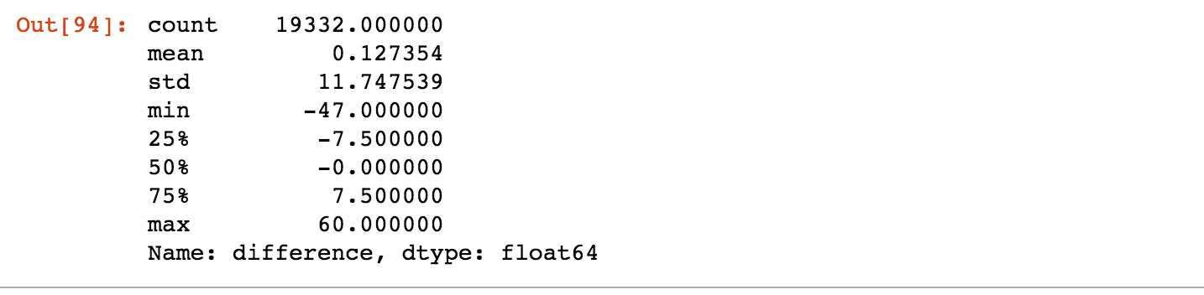
Summary Statistics for 2003-2016

Slide 14
Data Collection
I scraped basketball-reference.com for box score data.
Shout out to Richard for checking out my Github code on the scrape
I looped through basketball-references.com/boxscores to grab each box score.

Slide 15
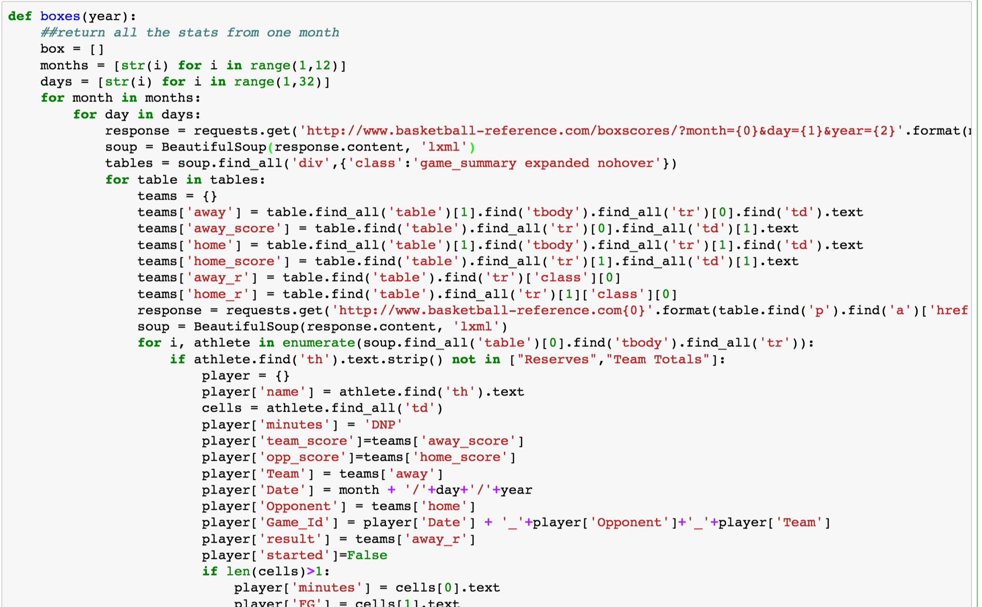
Beautiful Soup

Slide 16
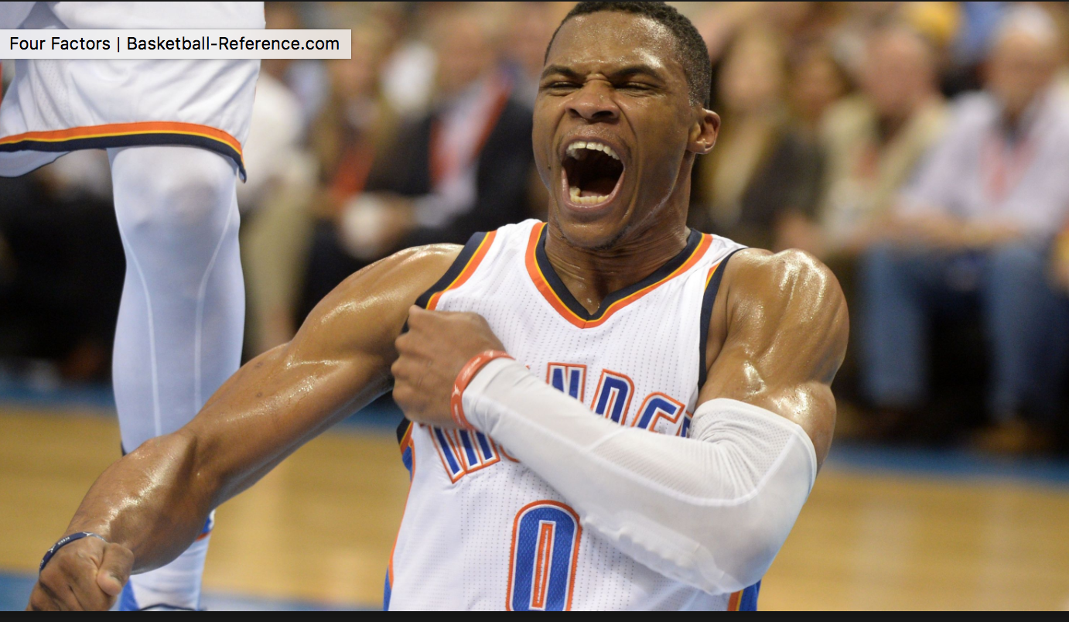
Baseline
In the 2016-2017 season, the home team beat the spread 50.4% of the time

Slide 17
Four Factors
Created by Dean Oliver, statistician. Basketball on Paper
Shooting- measured using eFG%
(FG+.5*3P)/FGA
Turnovers- measured with TO%
TOV / (FGA + 0.44 * FTA + TOV)
Offensive Rebounding- ORB%
ORB / (ORB + Opp DRB)
Defensive Rebounding – DRB%
DRB / (Opp ORB + DRB)
Free Throws- - FT factor
FT / FGA

Slide 18
Features
The model takes in the following features for both teams:
3P
3PA
DRB%
ORB%
PPG
TOV%
win percent
Played last night
Played road game last night
FT factor
Distance from last game

Slide 19
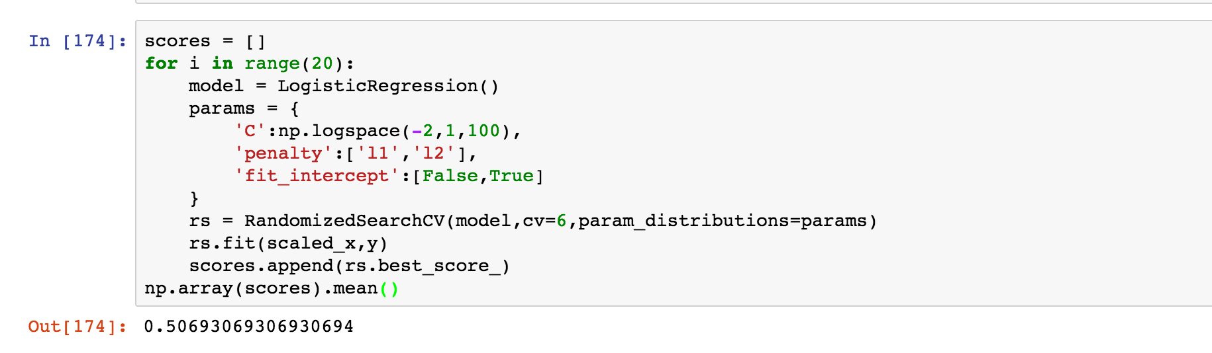
Logistic Regression

Slide 20
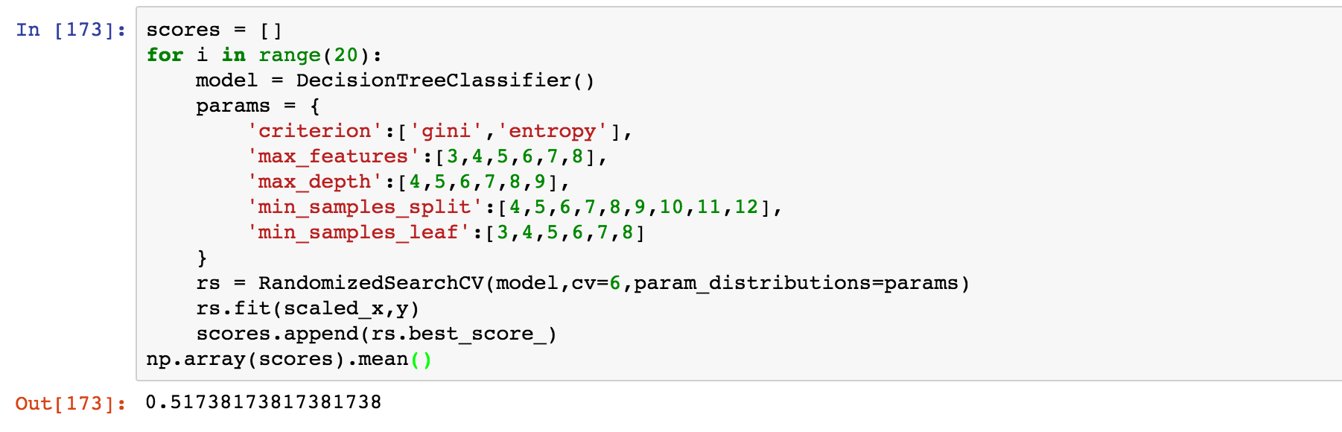
Decision Tree

Slide 21
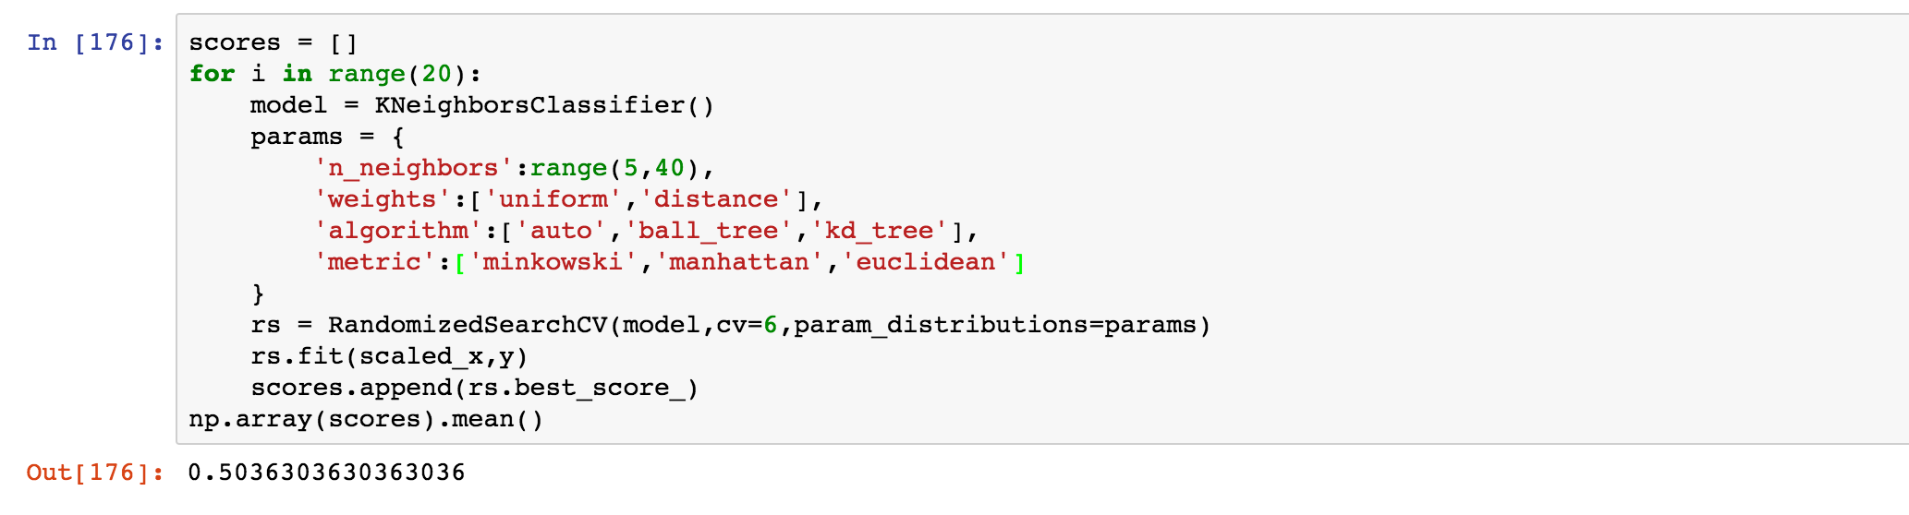
K Nearest Neighbors

Slide 22
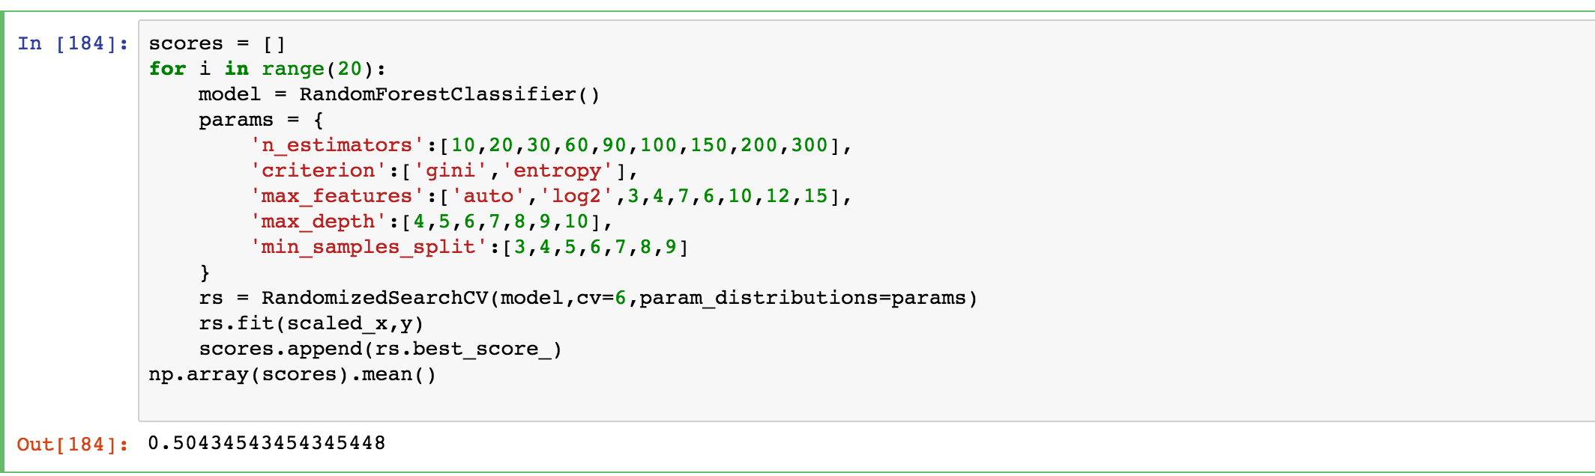
Random Forest Classifier

Slide 23
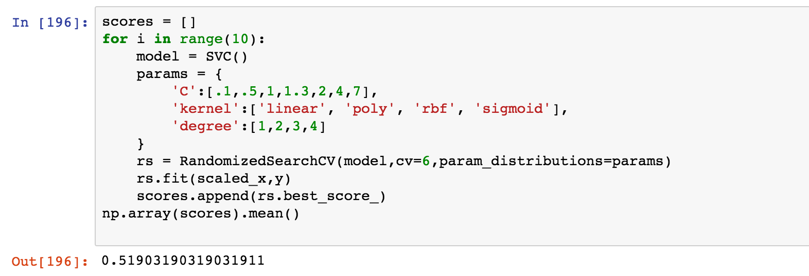
SVM

Slide 24
Try PCA with more features?
Next, I included all of the features that I scraped, while also using some advanced statistics, such as eFG%
I looked at both teams statistics, as well as their opponents statistics.
For example, there are four features for points per game: ppg_home, opp_ppg_home, ppg_away, opp_ppg_away

Slide 25
Full List of Features
['3P_home', '3P%_home', '3PA_home', 'DRB%_home', 'EFG%_home', 'FT_factor_home', 'ORB%_home', 'PPG_home', 'TOV%_home','opp_3P_home', 'opp_3P%_home', 'opp_3PA_home', 'opp_DRB%_home', 'opp_EFG%_home', 'opp_FT_factor_home', 'opp_ORB%_home', 'opp_PPG_home', 'opp_TOV%_home', 'win_percent_home','Days_Since_home','played_road_last_night_home', 'played_diff_loc_last_night_home', '3P_away', '3P%_away', '3PA_away', 'DRB%_away', 'EFG%_away', 'FT_factor_away', 'ORB%_away', 'PPG_away', 'TOV%_away','opp_3P_away', 'opp_3P%_away', 'opp_3PA_away', 'opp_DRB%_away', 'opp_EFG%_away', 'opp_FT_factor_away', 'opp_ORB%_away', 'opp_PPG_away', 'opp_TOV%_away','win_percent_away','Days_Since_away','distance_From_Last_Game_home','played_road_last_night_away', 'played_diff_loc_last_night_away']

Slide 26
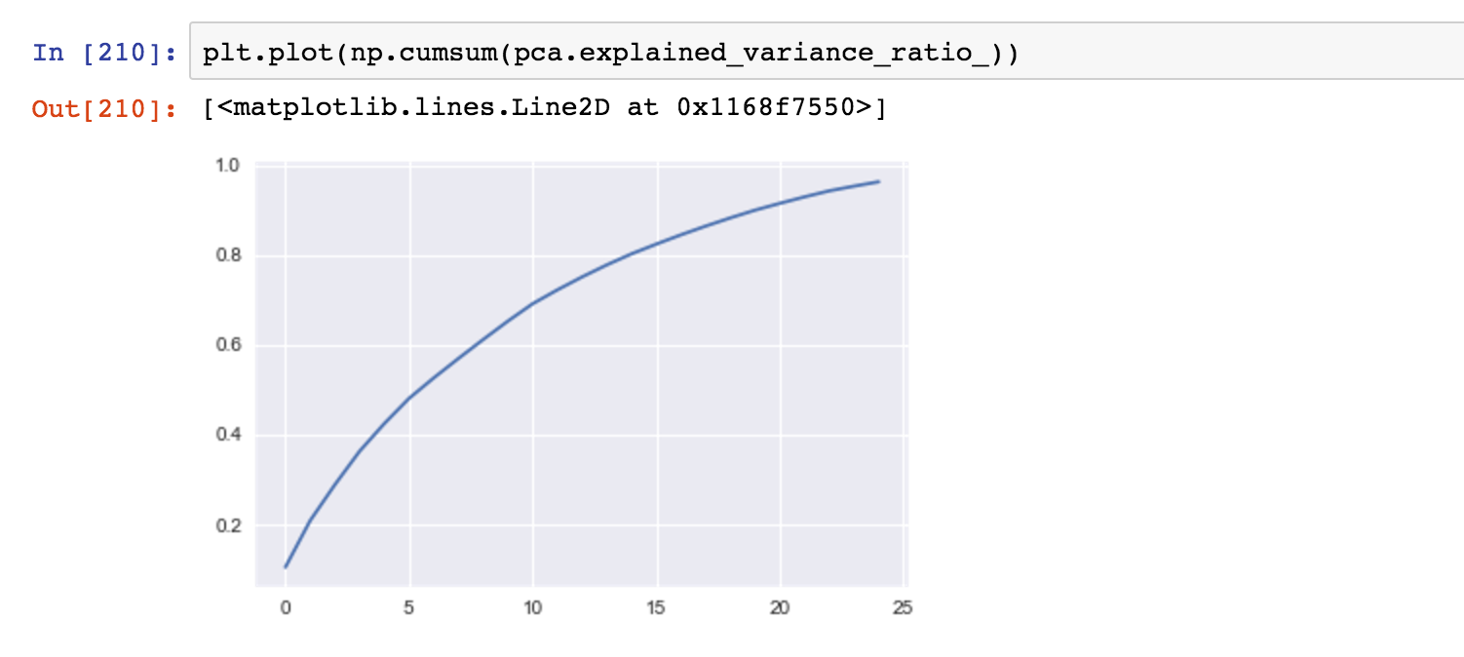
Explained Variance

Slide 27
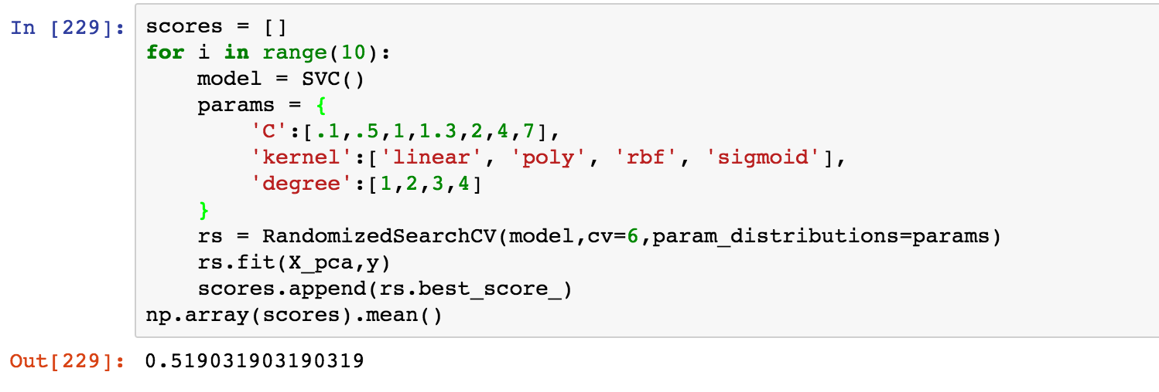
PCA with SVM

Slide 28
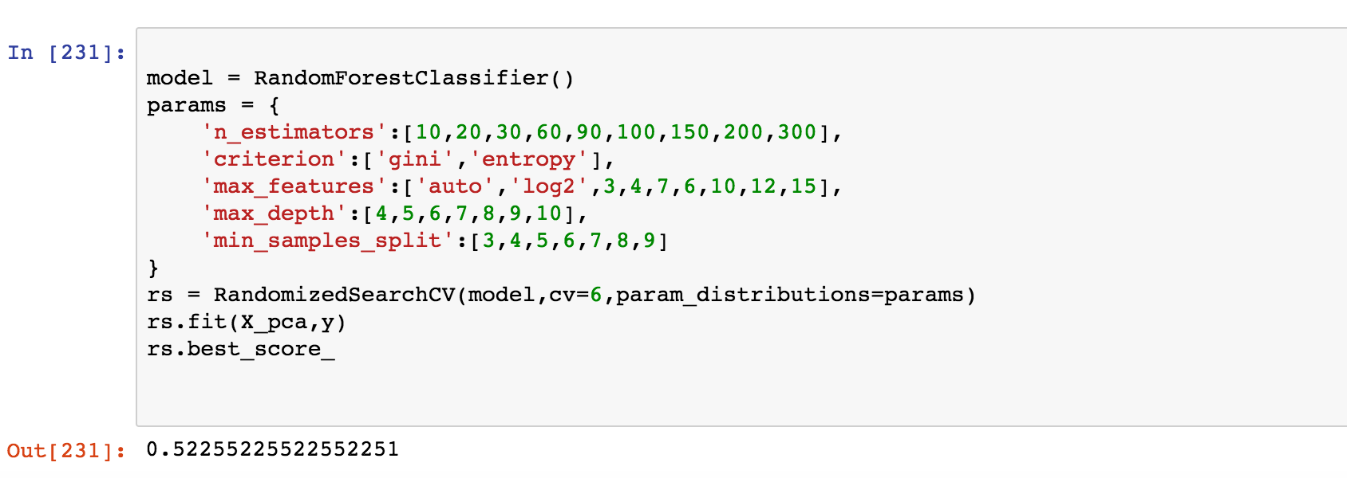
PCA with Random Forest

Slide 29
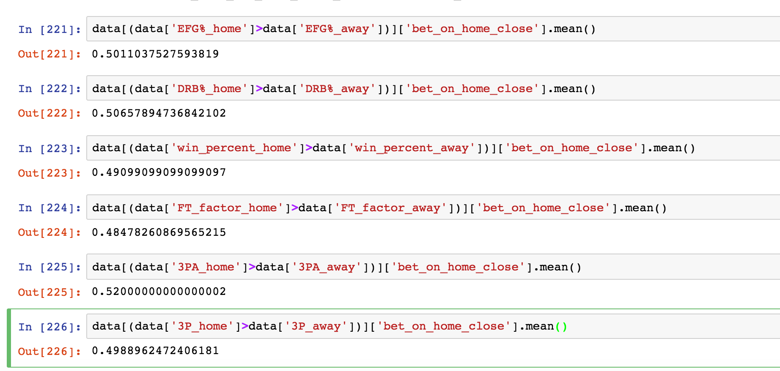
Isolating Some Features

Slide 30
Central Limit Theorem
Some of these feature isolations have a mean less than .5. Do they have a negative impact on picking a side?
All of the numbers I have calculated have been pretty damn close to the baseline of .504.
The best result I have is the dimensionally reduced Random Forest, where I got .522

Slide 31
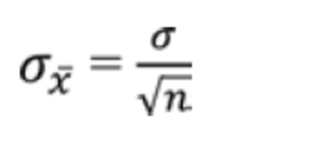
Central Limit Theorem
Let’s assume that the model produces no information. This is our null hypothesis.
I have essentially flipped a coin a bunch of times and sometimes heads is a little bit stickier.
What is the probability I would get heads 52.2% of the time due to random chance?
The sample size is approximately 900. We know from the Central Limit Theorem that the standard deviation of the distribution of sample means is the standard deviation of the original distribution divided by the square root of n

Slide 32
CLT (cont.)
Variance of Bernoulli distribution with mean .5 = .5*.5 = .25
Variance of distribution of sample means =.25/909= .000275.
Standard deviation of distribution of sample means = sqrt(.000275) = .0165
We also know that the distribution of sample means is approximately normal (from CLT)

Slide 33
Getting 52.2% wins?
The chance of getting this by random chance is (.522-.5)/.0165 =1.33 standard deviations from the mean.
Let’s assume the null hypothesis is that our model produces the same result as randomly picking a side. So, it is essentially a coin flip.
For a one sided test, there is roughly a 9.7% chance that this would happen given the null hypothesis.
With an alpha level of .05, we cannot reject the null hypothesis.

Slide 34
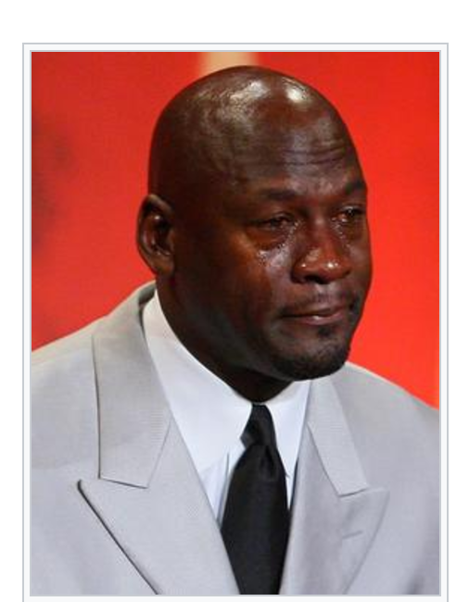
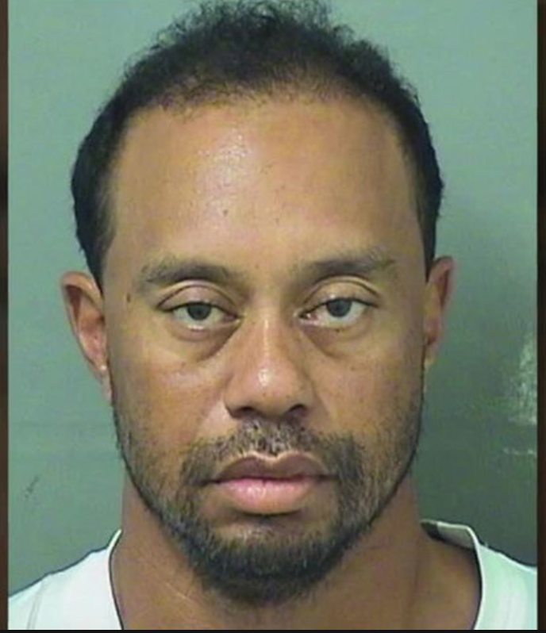
Summary

Slide 35
Summary (cont.)
Vegas is good.
If you want to make money betting on sports, maybe NBA point spreads is not the right niche.
Different approaches:
Analyze each feature separately. Spend more time feature engineering.
Cluster games by type, using features such as game pace, DRB%, location, back-to-back road games, team styles, size, PPG, etc.
Make sure to incorporate if a star player is out. Calculate percentage of different areas of production missing on a certain night and use these as features. Could use a decision tree.
Somehow quantify mismatches. For example, a small team would have a tough time guarding a quality center.
Quantify “star power” – playmakers that regularly impact the outcome of a game
Use a neural network
Copy someone else

Slide 36
Conclusion
Maybe Vegas has the perfect model.
But wait, all models are wrong.
”All Models Are Wrong”
-George Box
- Nichole Bennett
-Cliff Eversdyk
-Andrew Adelson

Slide 37
Conclusion (cont.)
Because Vegas has more data, lots of odds makers that can bag their models, that can then be bagged with other odds makers models, I don’t like my chances of finding greater than 52.63% of beating the spread on all games.
I don’t think it is impossible.
I do think that one should be very selective in deciding on which games to bet. There needs to be a significant disparity between your model and the Vegas line. This would lend itself toward regression instead of classification
A model that just uses statistics from within one season is highly unlikely to prove profitable. Other features must be introduced.

Slide 38
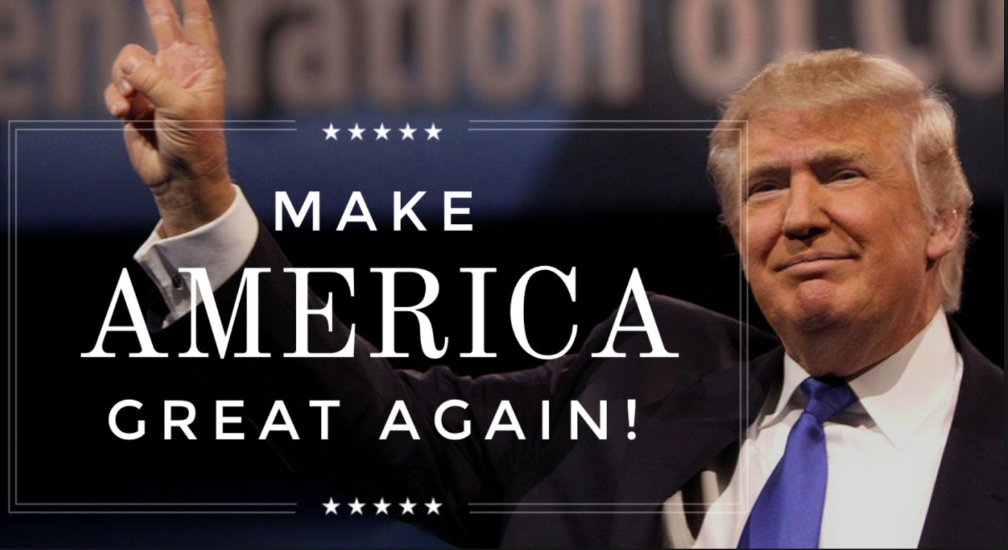
The End

